Slide 1
PYTHON PROJECT ON ONLINE PRODUCTS
PRESENTED BY:
NAME : G.SUPRAJA
ID NO : AF04957411

Slide 2
OVERVIEW :
The project called as online products is an analyzation of the whole data in it in terms of sales , quality, price, category, brand etc..
It extracts the insights using visualization techniques and data analyzation.
The whole code is written in python using Numpy, Pandas and Matplotlib.

Slide 3
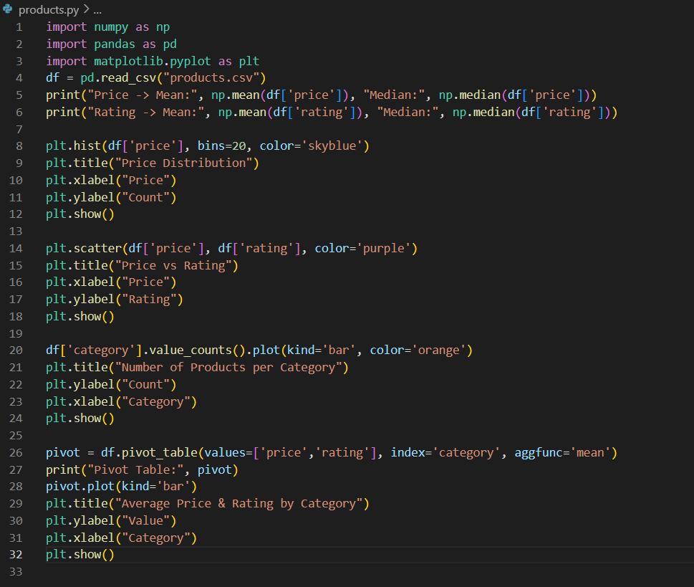
Source Code :

Slide 4
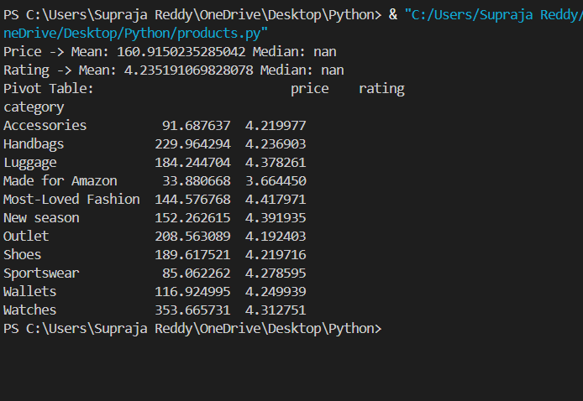
OUTPUTS :

Slide 5
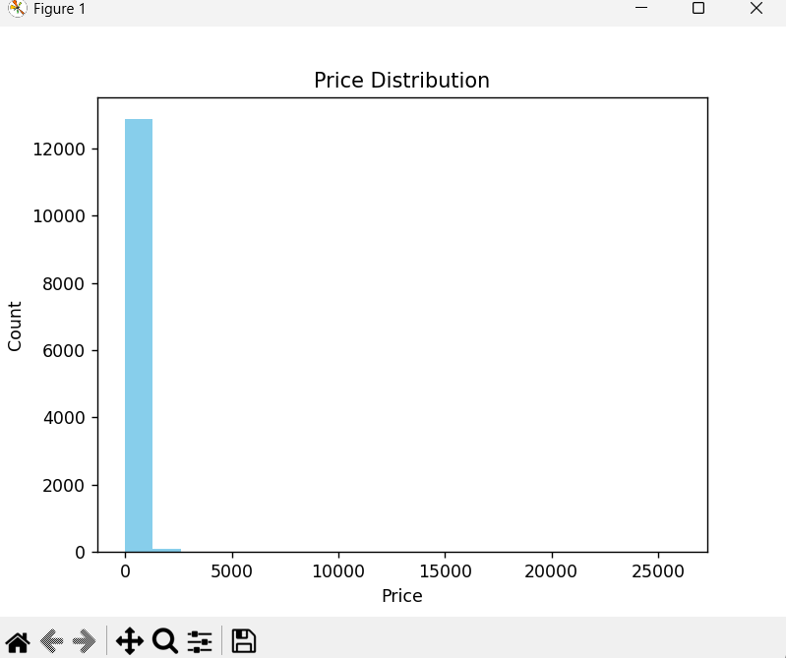
HISTOGRAM ON PRICE DISTRIBUTION

Slide 6
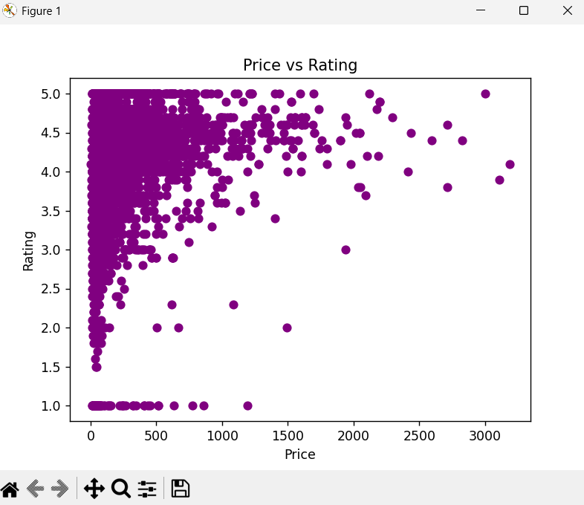
SCATTER plot ON PRICE VS RATING

Slide 7
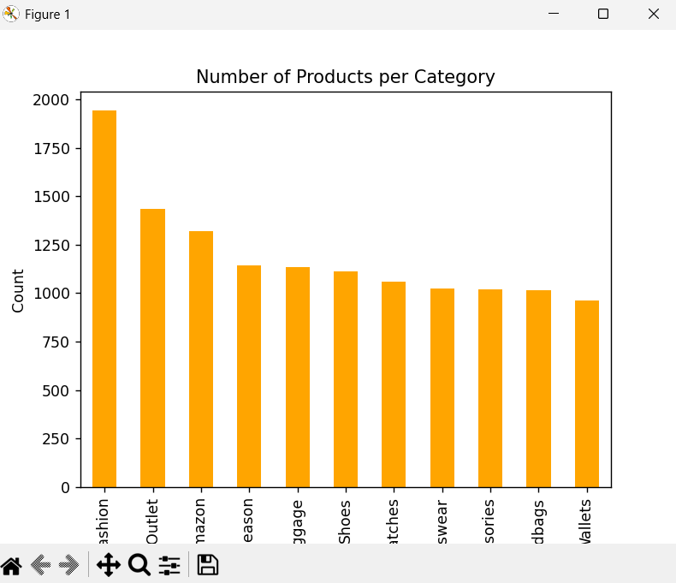
NUMBER OF PRODUCTS PER CATEGORY

Slide 8
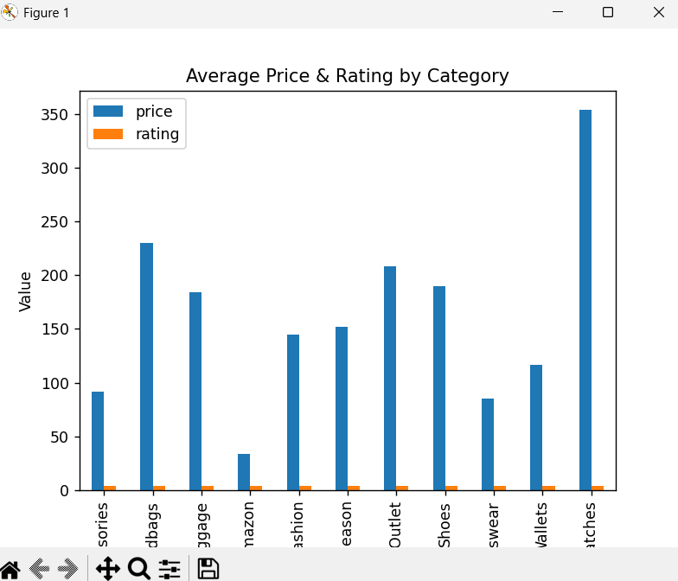
AVERAGE PRICE AND RATING BY CATEGORY

Slide 9
CONCLUSION :
The Online Products consists of data such as name, brand, price , rating, category and URLs.
We can see easy visualization techniques like Scatter Plots, Bar Charts and Histograms .
Because of the methods that we perform here, it is easily to analyze and understand the details of the online products.

Slide 10
THANK YOU

